Slide 1
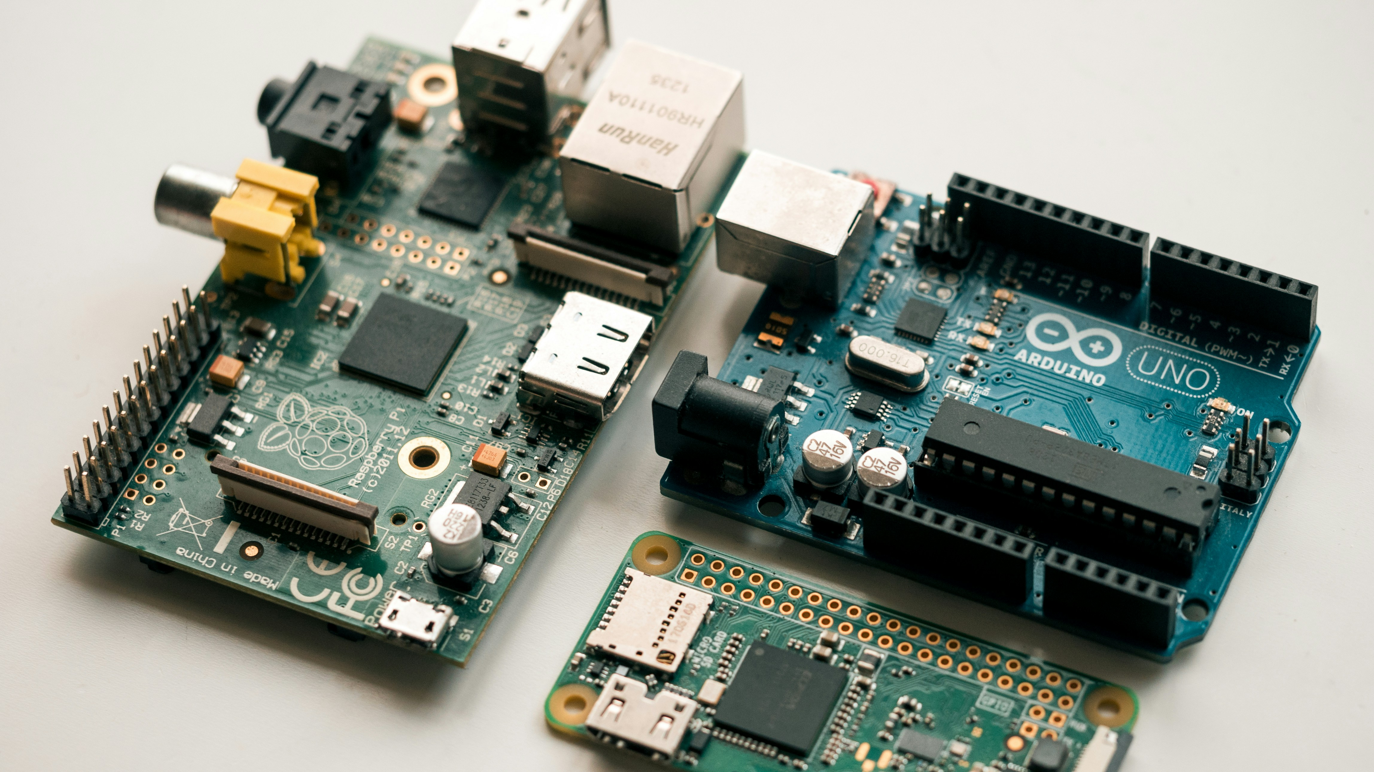
Smart Electronic Component Inventory Management System
A C++ Solution for Labs, Workshops, and Makerspaces
Streamlining stock control, valuation, and project planning
Bright Sakyiamah( PowerPoint Presenter)
Group 1.6

Slide 2
Where is this System Needed?
Educational Labs: Schools and University engineering laboratories.
Repair shops: Commercial electronics repair facilities.
Marketspaces: Community workspaces and innovation hubs.
High Volume Parts: Managing resistors, capacitors, LEDs, diodes, transistors, jumper wires, sensors, and microcontrollers

Slide 3
The Problem
The Choas of Unmanaged Inventory.
Zero Visibility: Users do not know available quantities.
Financial Blind spot: Total stock value remains completely unknown.
Project Delays: Missing components halt practical works.
Poor Planning: Inability to order parts before they run out.

Slide 4
Project Objective
Bridging the Gap With Software.
Student-Led Project: Develop a lightweight, terminal-based C++ application.
Core Goal: Provide an efficient way to track and value electronic components.
Key Outcome: Prevent project delays through automated low-stock alerts.
Data Persistence: Ensure inventory data survives after closing the program.

Slide 5
Core Functional Requirements
What the System Must Do
Record Components: Add new items with names, categories, quantities, and prices.
Calculate Value: Automatically compute individual and total inventory financial value.
Low-Stock Alerts: Instantly flag items that fall below a set threshold.
Report Generation: Save data to a file for future reference and external viewing.

Slide 6
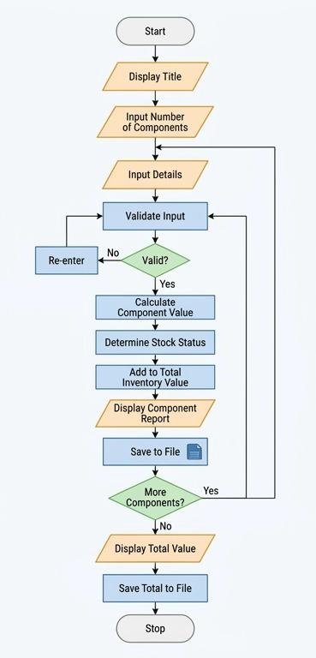
System Architecture & Data Structure

Slide 7
Software Workflow
Step-by-Step Application Logic
Step 1: Initialization: Program boots and loads existing data from a text/CSV file.
Step 2: User Menu: Interactive CLI console options (Add, View, Alerts, Export, Exit).
Step 3: Processing: Logic calculates total value (Quantity \(\times \) Unit Price).
Step 4: Termination: Program saves updated lists back to the file and closes safely.

Slide 8
Conclusion & Impact
Empowering Efficient Workspaces
Eliminates Human Error: Replaces unreliable manual logbooks with digital tracking
Saves Time & Money: Optimizes purchasing budgets and prevents duplicate orders.
Educational Growth: Students solve a tangible, real-world logistics problem using code.

